Slide 1










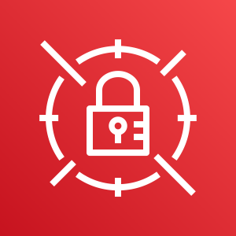
AWS Cloud
Availability Zone
Availability Zone
VPC
Internet gateway
Public subnet
Public subnet
Auto Scaling group
NAT gateway
RD Gateway
RD Gateway
NAT gateway
AWS Systems Manager
Private subnet
Private subnet
AWS Secrets Manager
Domain Controller 1
Domain Controller 2

Slide 2





AWS Cloud
Availability Zone
Availability Zone
VPC
Internet gateway
AWS Systems Manager
Public subnet
Public subnet
Auto Scaling group
On premises
NAT gateway
RD Gateway
RD Gateway
NAT gateway
AWS Secrets Manager
Private subnet
Private subnet
VPN gateway
VPN connection
Customer gateway
DC/GC/DNS
(DC)
Active Directory
Domain Controller 1
Domain Controller 2
Active Directory replication

Slide 3

AWS Cloud
Availability Zone
Availability Zone
VPC
Internet gateway
Public subnet
Public subnet
Auto Scaling group
AWS Systems Manager
NAT gateway
RD Gateway
RD Gateway
NAT gateway
AWS Secrets Manager
Private subnet
Private subnet
AWS Directory Service
Management Instance

